Slide 1
PC5 Default CXL.IO memory map
Notes from PC5 acerun.log

Slide 2
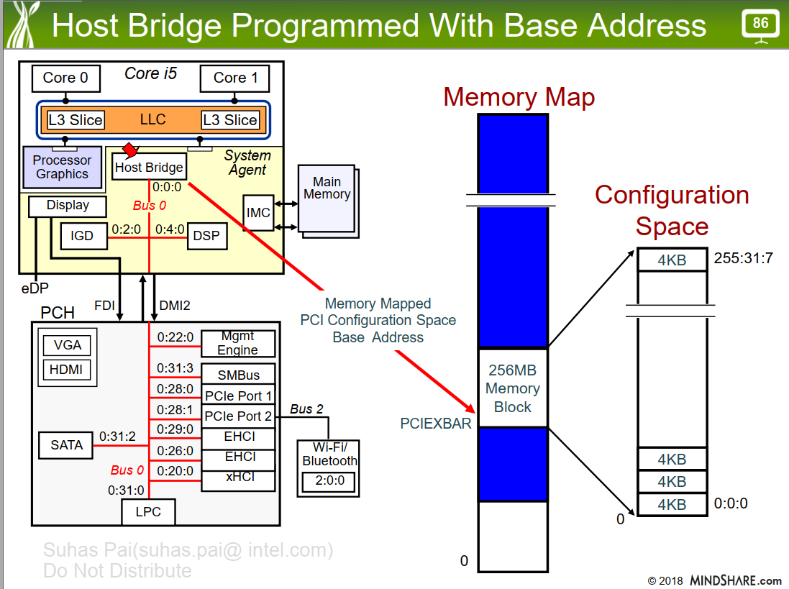

Slide 3
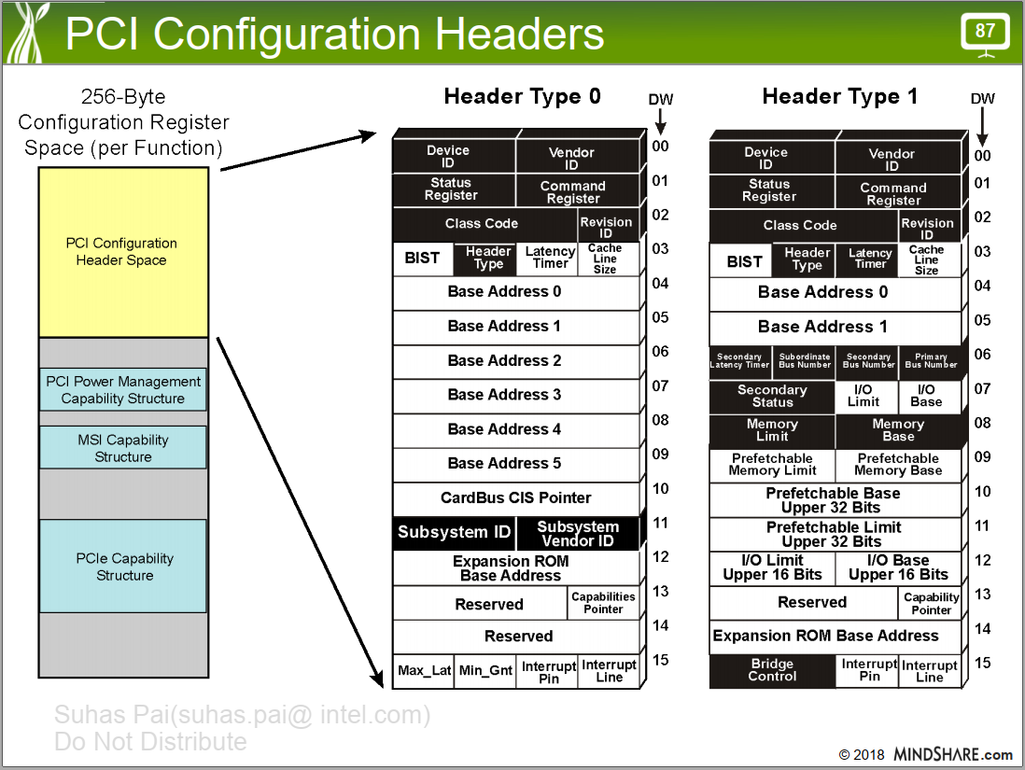

Slide 4
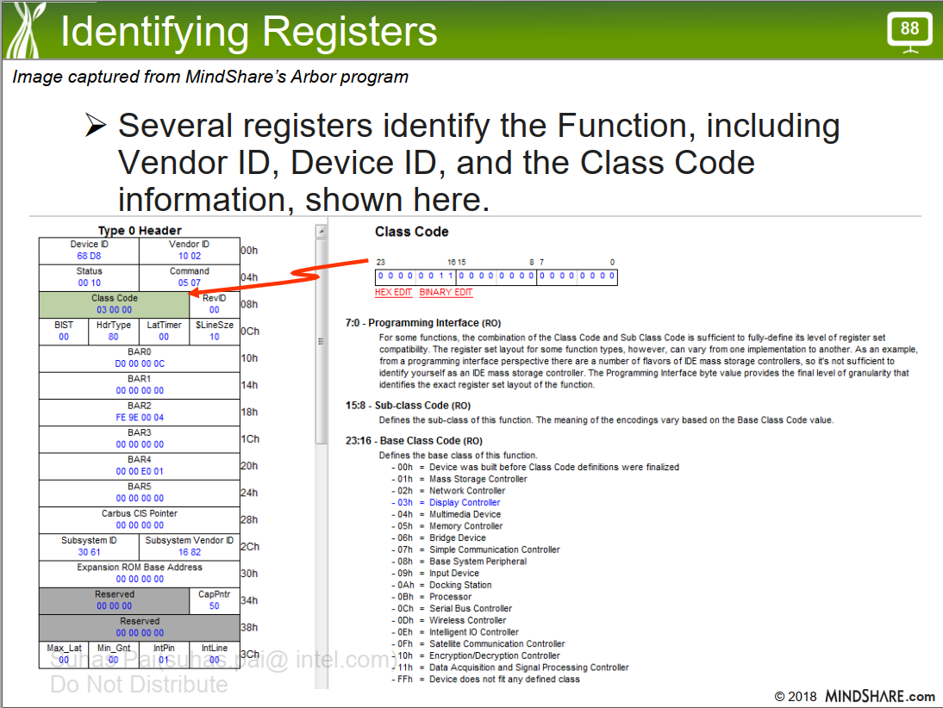

Slide 5
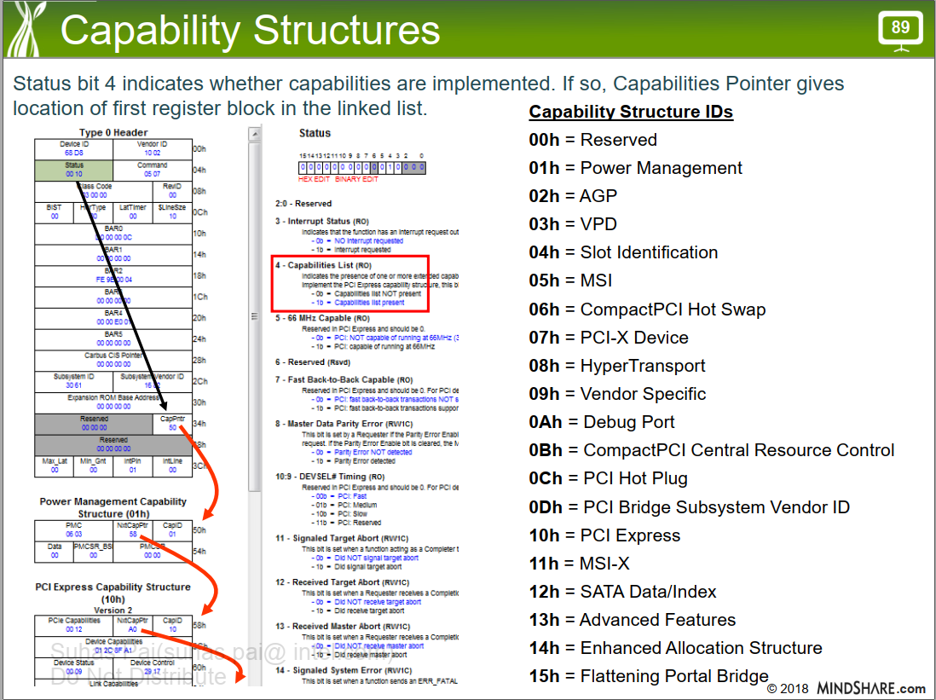

Slide 6
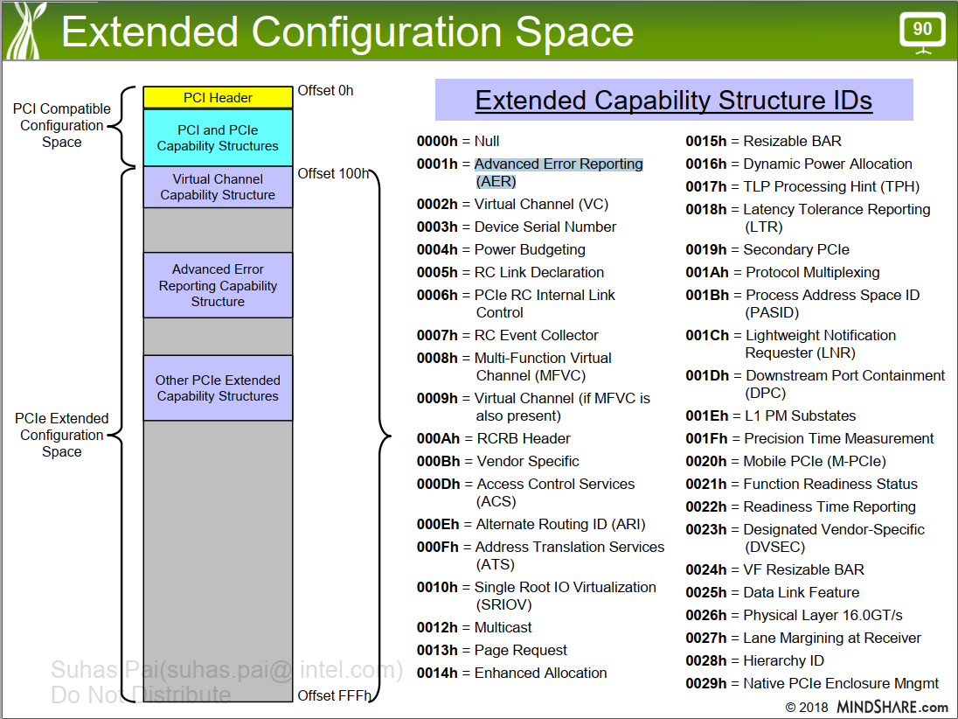

Slide 7
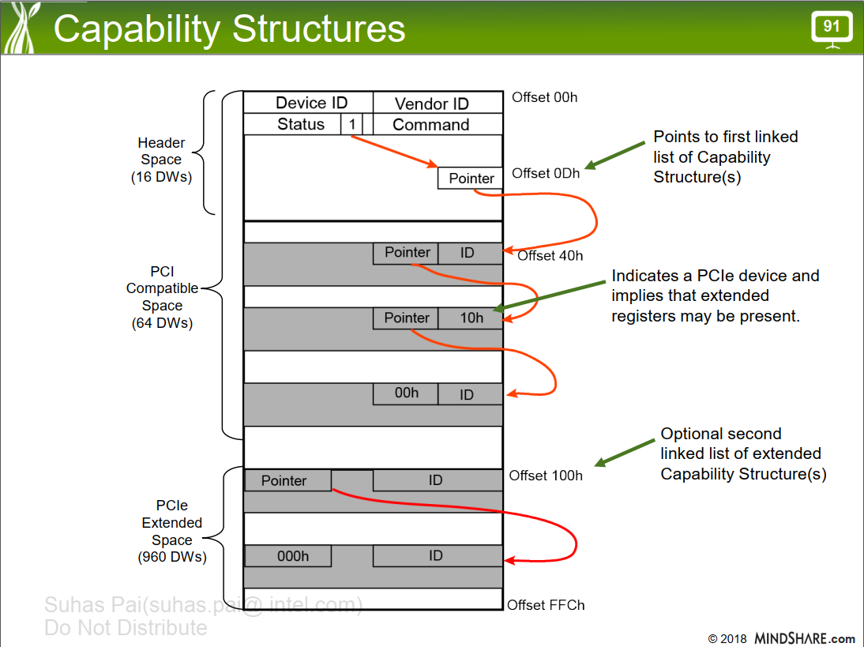

Slide 8
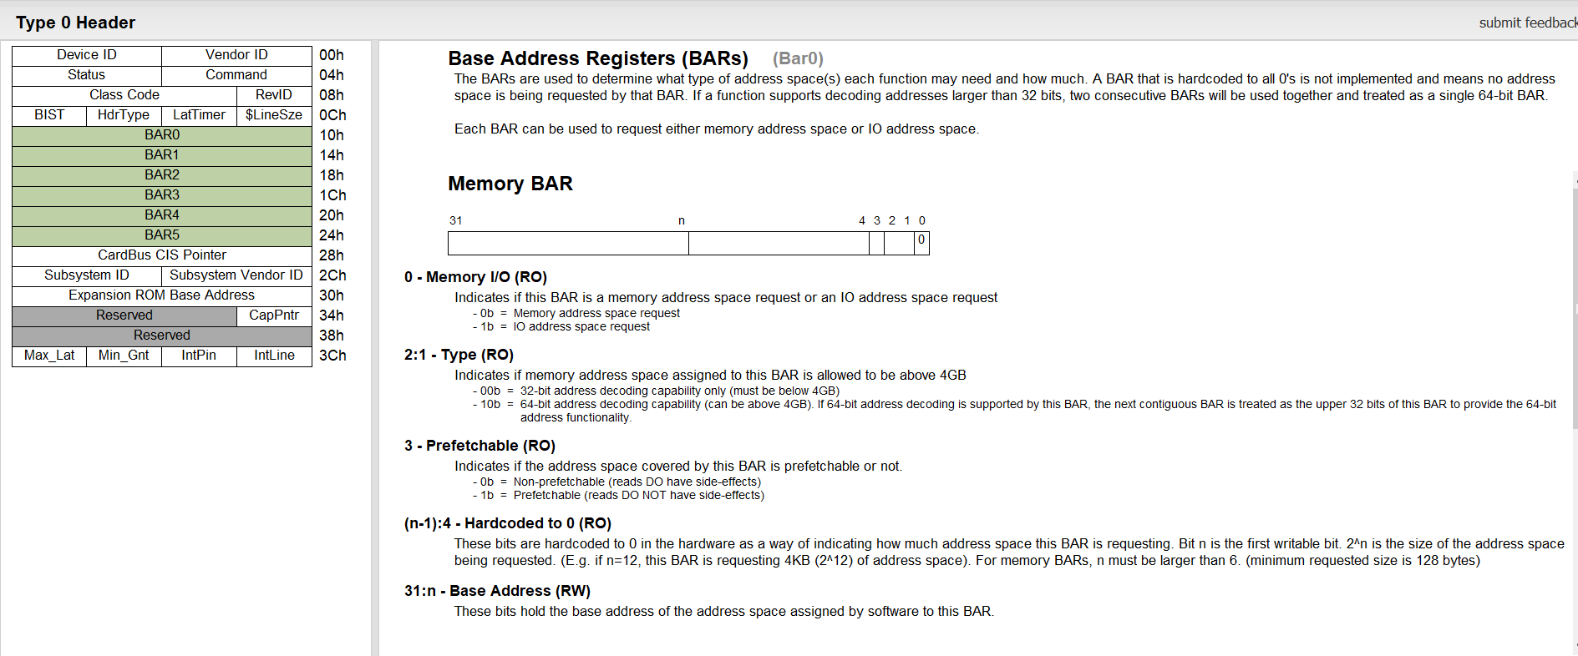
BAR SIZE CALC

Slide 9
Output from acerun.log.gz
From: /nfs/site/disks/ive_gnr_pss_cxl_cadence/yugeshgx/cosim/cadence_simics1_memtest19c/gnrsp_ip-srvr10nm/regression/pc5/pi5/save_par.list/pi5_base_test_save_snapshot_fsdb_fsdb/acerun.log
OVM_INFO /nfs/site/disks/ive_gnr_pss_cxl_cadence/yugeshgx/cosim/cadence_simics1_memtest19c/gnrsp_ip-srvr10nm/verif/tb/env/pi5_ovm_cfg.sv(802) @ 0.000ns: reporter [pi5_ovm_cfg] For Port0 SEC_BUS is: 1, SUB_BUS is: 2, ADDRESS_LOW is: 1000000, ADDRESS_HIGH is: 2ffffff
OVM_INFO /nfs/site/disks/ive_gnr_pss_cxl_cadence/yugeshgx/cosim/cadence_simics1_memtest19c/gnrsp_ip-srvr10nm/verif/tb/env/pi5_ovm_cfg.sv(866) @ 0.000ns: reporter [pi5_ovm_cfg] populate_pcie_memmap IO base:1000 Limit:1fff for Port:0
OVM_INFO /nfs/site/disks/ive_gnr_pss_cxl_cadence/yugeshgx/cosim/cadence_simics1_memtest19c/gnrsp_ip-srvr10nm/verif/tb/env/pi5_ovm_cfg.sv(873) @ 0.000ns: reporter [pi5_ovm_cfg] populate_pcie_memmap MMIO base:e0000000 Limit:e0ffffff
OVM_INFO /nfs/site/disks/ive_gnr_pss_cxl_cadence/yugeshgx/cosim/cadence_simics1_memtest19c/gnrsp_ip-srvr10nm/verif/tb/env/pi5_ovm_cfg.sv(1052) @ 0.000ns: reporter [pi5_ovm_cfg] populate_pcie_memmap for Port: 0 BAR01 base:10020000000 Limit:1002001ffff
OVM_INFO /nfs/site/disks/ive_gnr_pss_cxl_cadence/yugeshgx/cosim/cadence_simics1_memtest19c/gnrsp_ip-srvr10nm/verif/tb/env/pi5_ovm_cfg.sv(1100) @ 0.000ns: reporter [pi5_ovm_cfg] populate_pcie_memmap for Port: 0 RCRBBAR base:10020030000 Limit:10020031fff
OVM_INFO /nfs/site/disks/ive_gnr_pss_cxl_cadence/yugeshgx/cosim/cadence_simics1_memtest19c/gnrsp_ip-srvr10nm/verif/tb/env/pi5_ovm_cfg.sv(1105) @ 0.000ns: reporter [pi5_ovm_cfg] populate_pcie_memmap for Port: 0 KeyConfigBar base:10020032000 Limit:10020032fff
OVM_INFO /nfs/site/disks/ive_gnr_pss_cxl_cadence/yugeshgx/cosim/cadence_simics1_memtest19c/gnrsp_ip-srvr10nm/verif/tb/env/pi5_ovm_cfg.sv(1111) @ 0.000ns: reporter [pi5_ovm_cfg] populate_pcie_memmap for Port: 0 CxlrbBar base:10020020000 Limit:1002002ffff

Slide 10
/nfs/site/disks/ive_gnr_pss_cxl_cadence/yugeshgx/cosim/cadence_simics1_memtest19c/gnrsp_ip-srvr10nm/regression/pc5/pi5/save_par.list/pi5_base_test_save_snapshot_fsdb_fsdb/pcie_stack_0_0_memmap.out
--------------------------------------------------------------------------------------
pcie0 MEM Ranges
--------------------------------------------------------------------------------------
pcie0 MEM 0000000000000000 : 000000000009ffff legal Hole MMIO
pcie0 MEM 00000000000c0000 : 00000000dfffffff legal Hole MMIO
pcie0 MEM 00000000e1000000 : 000001001fffffff legal Hole MMIO
pcie0 MEM 0000010020010000 : 00000100207fffff legal Hole MMIO
pcie0 MEM 0000010020900000 : ffffffffffffffff legal Hole MMIO
--------------------------------------------------------------------------------------
pcie0 MEM 00000000000a0000 : 00000000000bffff illegal VGA MMIO
pcie0 MEM 00000000e0000000 : 00000000e0ffffff illegal MMIO MMIO
pcie0 MEM 0000010020000000 : 000001002000ffff illegal MBAR01 MMCFG
pcie0 MEM 0000010020800000 : 00000100208fffff illegal PREFETCH MMIO
--------------------------------------------------------------------------------------

Slide 11
/nfs/site/disks/ive_gnr_pss_cxl_cadence/yugeshgx/cosim/cadence_simics1_memtest19c/gnrsp_ip-srvr10nm/regression/pc5/pi5/save_par.list/pi5_base_test_save_snapshot_fsdb_fsdb/simrun.dut_cfg
Socket 0, HIOP 0, PCIE port 0
addr_map::mem::region::MMIO_HIGH::subregion::s0_mmioh::subregion::s0_hiop0_mmioh::subregion::s0_hiop0_pcie0_0_mmioh::addr_hi = 0x100_208f_ffff ← prefetchable
addr_map::mem::region::MMIO_HIGH::subregion::s0_mmioh::subregion::s0_hiop0_mmioh::subregion::s0_hiop0_pcie0_0_mmioh::addr_lo = 0x100_2080_0000
addr_map::mem::region::MMIO_HIGH::subregion::s0_mmioh::subregion::s0_hiop0_mmioh::subregion::s0_hiop0_pcie0_0_mmioh::size = 0x10_0000
addr_map::mem::region::MMIO_HIGH::subregion::s0_mmioh::subregion::s0_hiop0_mmioh::subregion::s0_hiop0_pcie0_0_rootportmbar_mmioh::subregion::s0_hiop0_pcie0_0_bar0::addr_hi = 0x100_2001_ffff
addr_map::mem::region::MMIO_HIGH::subregion::s0_mmioh::subregion::s0_hiop0_mmioh::subregion::s0_hiop0_pcie0_0_rootportmbar_mmioh::subregion::s0_hiop0_pcie0_0_bar0::addr_lo = 0x100_2000_0000
addr_map::mem::region::MMIO_HIGH::subregion::s0_mmioh::subregion::s0_hiop0_mmioh::subregion::s0_hiop0_pcie0_0_rootportmbar_mmioh::subregion::s0_hiop0_pcie0_0_bar0::size = 0x2_0000

Slide 12
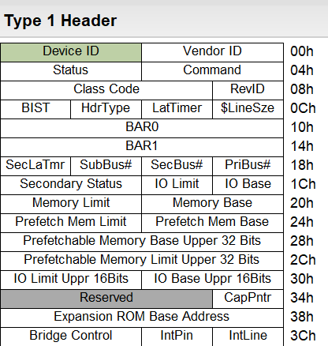
PCIE Type-1 Header

Slide 13
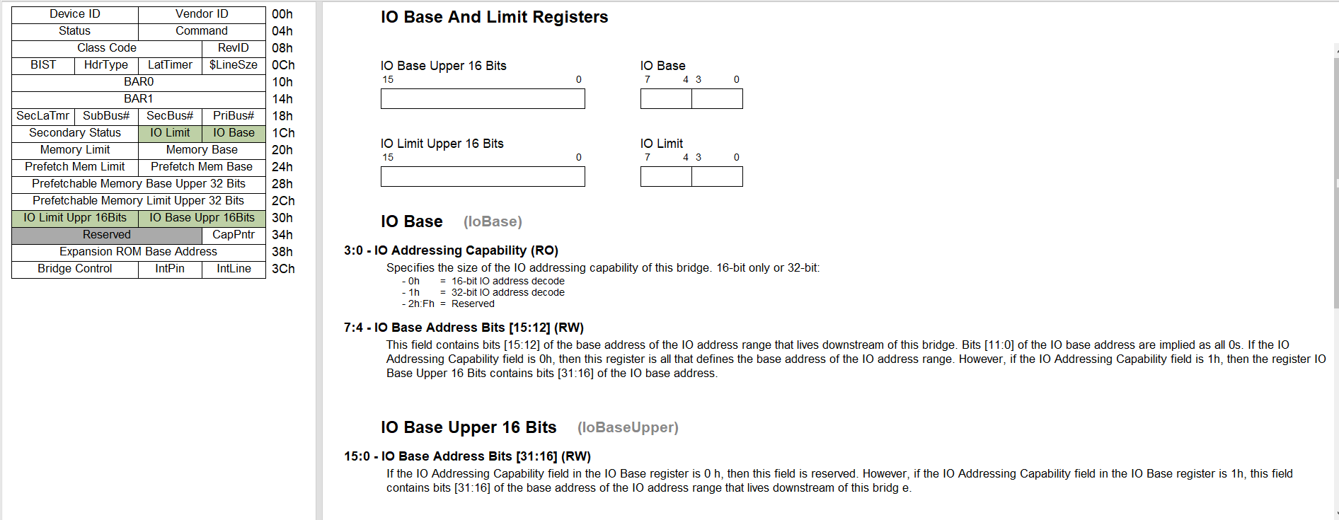
IO Registers IO base:1000 Limit:1fff for Port:0

Slide 14
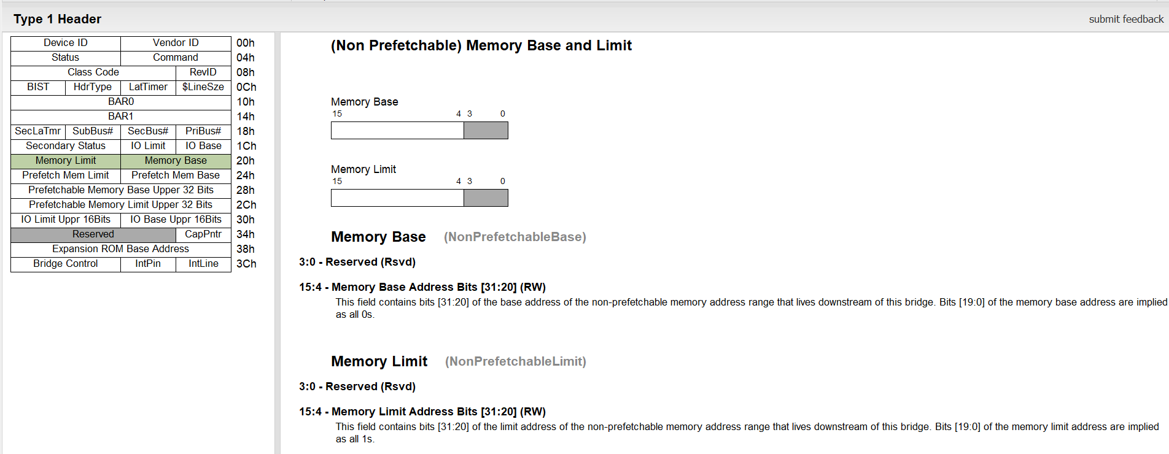
Non Prefetchable Registers MMIO base:e000_0000 Limit:e0ff_ffff

Slide 15
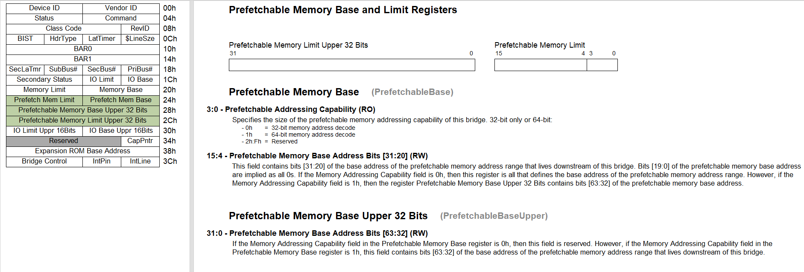
Prefetchable Base Port: 0 BAR01 base:100_2000_0000 Limit:100_2001_ffff

Slide 16
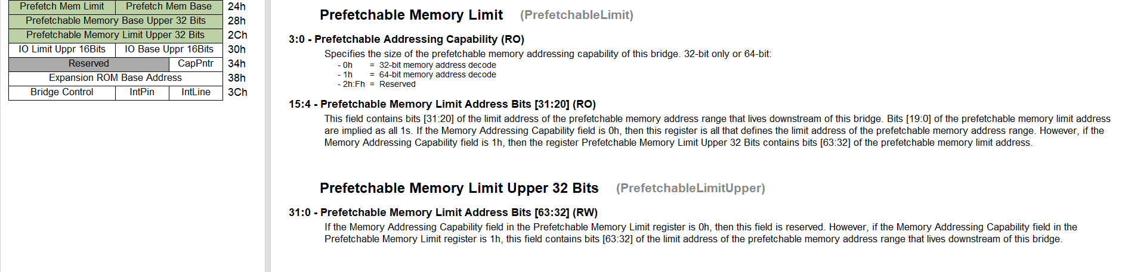
Prefetchable Limit Port: 0 BAR01 base:100_2000_0000 Limit:100_2001_ffff

Slide 17
CXL registers
Port: 0 RCRBBAR base:100_2003_0000 Limit:100_2003_1fff (8K)
Port: 0 KeyConfigBar base:100_2003_2000 Limit:100_2003_2fff (4K)
Port: 0 CxlrbBar base:100_2002_0000 Limit:100_2002_ffff (64K)

Slide 18
Base and limit registers
[10:37 PM] Loh, Kok Fong
Example RTL path for Prefetch:
gnrio_top_tb.gnrio_top.gnrio.iow.piu5_c0.pcu5common.paripi5encrypt.pcieg5_txn_x16.pgd.cxt_csr.gen_csr[0].port.iosf.pfbase
gnrio_top_tb.gnrio_top.gnrio.iow.piu5_c0.pcu5common.paripi5gen5x8.pcieg5_txn_x8.pgd.cxt_csr.gen_csr[2].port.iosf.pfbase
[10:39 PM] Loh, Kok Fong
other addr registers can be found at the same hierarchy too

Slide 19
[3:30 PM] Goura, Rohith
/nfs/site/disks/xpg_icxsp_0031/users/rgoura/pc5_sept20/gnrsp_ip-srvr10nm/verif/tb/wrappers/ti/cxl/rndc8x16cl_params.svh
[3:30 PM] Goura, Rohith
132 localparam bit PCIE_IS_PASSIVE = 1; 133 `else 134 //--rgoura--localparam bit PCIE_IS_PASSIVE = 0; 135 localparam bit PCIE_IS_PASSIVE = 1;

Slide 20
/nfs/site/disks/sdg74_ipr_gnr_0001/ip_releases/dcsg/pcie5/pcieg5_1p0-8-HF005-020822_hsd22014733694_0 > realpath $MODEL_ROOT/subIP/sip/pcieg5/val/env/config/PcieSharedPCIECons.svh
/nfs/site/disks/sdg74_ipr_gnr_0001/ip_releases/dcsg/pcie5/pcieg5_1p0-8-HF005-020822_hsd22014733694_0/val/env/config/PcieSharedPCIECons.svh
You can copy this file to $MODEL_ROOT/verif/patches directory and make local modifications to avoid randomization.
Disable pasid TLP prefix
cmd.process_addr_space_id == 64'hFFFF_FFFF_FFFF_FFFF;

Slide 21
PC5_COSIM
/nfs/site/disks/ive_gnr_pss_cxl_cadence/users/ysheenx/cosim/pc5cadence_turnin504214/gnrsp_ip-srvr10nm/verif/tb/seqlib/pi5/pi5_config_seq.sv

Slide 22
Register Access (Part-1)
Register Access Layer (RAL)
This layer allows programming and verification of register contents
It supports three access methods given below
Three register access methods using accessPath
IOSF sideband interface
Some registers can be only programmed only using this interface
string accessPath = "iosf_sb";
Primary or Frontdoor interface
This is how s/w would program registers except some that can be only programmed using iosf_sb
test_constraints primary_ral_constraints
accPath = “primary”
Backdoor interface
This is strictly used in verification collateral but not supported in the chip
automatic EipPcieEnvPkg::PcieCfgObj pcieg5_cfg_obj;
accPath = pcieg5_cfg_obj.getBackdoorRalAccess();

Slide 23
Register Access (Part-2)
New Files
$MODEL_ROOT/verif/tb/seqlib/pi5/pi5_cosim_enum_seq.sv
$MODEL_ROOT/verif/tb/seqlib/pi5/ovm_cosim_pcie_reg_prog_seq.sv
Modeled after $MODEL_ROOT/verif/tb/seqlib/pi5/ovm_basic_reg_access_seq.sv
Files changed (To register ovm_cosim_pcie_reg_prog_seq.sv)
$MODEL_ROOT/verif/tb/seqlib/pi5_seqlib.inc
Finding register names (e.g. “PFBASE”)
firefox $IP_MODELS/gnrsp_ip/gnrsp_ip-srvr10nm-pi5-latest/subIP/sip/pcieg5/doc/eip/pcierndc_eiprndc8p_regex.html
HAS specs
PC5 HAS: https://wiki.ith.intel.com/display/GNRIOPC5HAS/GNRIO+PC5

Slide 24
Register Access (Part 3) Example sources: /nfs/site/disks/xpg_sprsp_0307/users/gold/pc5_standalone/reg_programming
$MODEL_ROOT/verif/tb/seqlib/pi5/pi5_cosim_enum_seq.sv
virtual task body();
ovm_cosim_pcie_req_prog_seq pcie_reg_prog;
sla_seque
// Find reg name: firefox $IP_MODELS/gnrsp_ip/gnrsp_ip-srvr10nm-pi5-latest/subIP/sip/pcieg5/doc/eip/pcierndc_eiprndc8p_regex.html
// the following line needs to be placed at the point of execution. Example: PFBASE is the name of the register from the link above
`xvm_do_on_with(pcie_reg_prog, sla_seqr, {reg_name=="PFBASE", {reg_value==<whatever simics or testhost provides>;});
$MODEL_ROOT/verif/tb/seqlib/pi5_seqlib.inc
`ifndef VUNIT_TEST_ENV
`include "pi5_base_ovm_seq.sv"
`include "ovm_basic_reg_access_seq.sv"
`include "ovm_cosim_pcie_reg_prog_seq.sv"
`include "rst/pi5_rstw_daisy_chain_seq.sv“
$MODEL_ROOT/verif/tb/seqlib/pi5/ovm_cosim_pcie_reg_prog_seq.sv (relevant code)
class ovm_cosim_pcie_reg_prog_seq extends pi5_base_ovm_seq;
automatic EipPcieEnvPkg::PcieCfgObj pcieg5_cfg_obj; //← accPath
accPath = pcieg5_cfg_obj.getBackdoorRalAccess();
rand bit [31:0] reg_value; //← user defined
rand string reg_name;
`ifdef PI5_PCIEG5_ENABLE //← programming
`ifndef VUNIT_TEST_ENV
if(pi5_ovm_cfg_i[comp_idx].pc5_ip_en[PI5::PC5_IP_PCIE_X16]) begin
foreach (pcie0G5CfgObj.port[i]) begin
if (pcie0G5CfgObj.port[i].isActive) begin
ralReg = ral.find_file($sformatf("i_pcieg5_tb_env_pcie_stack_0_0.pcie_stack_0_0.rp%0d", i)).find_reg(reg_name);
doFullWriteReadAndCompare(ralReg, reg_value); // <------------this is where the write takes place
//doFieldWriteReadAndCompare(ralReg, {"ICT"}, {$urandom_range(8'h11,8'h20)}); // <--- Use this task to program fields
end
end
end
`endif
`endif // `ifdef PI5_PCIEG5_ENABLE

Slide 25
Debugging UR

Slide 26
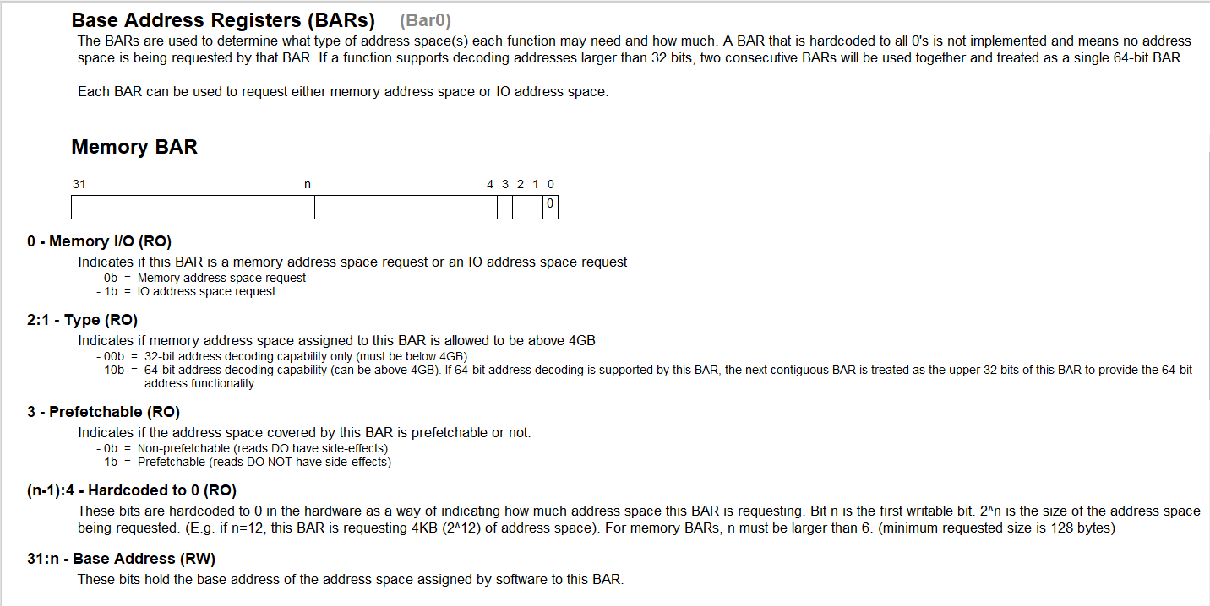

Slide 27
RAMBUS BAR programming
BAR | Address | Write | Read | Program BARs | Analysis
BAR0 | 0x10 | 0xFFFF_FFFF | 0xFFFF_F00C | 0x1111_0000 | 0xC=1100➔ Pre, 64-Addr, MemSpace BAR01=0x0000_0000_1111_0000 SIZE = 2^12 = 4K =(0x0000-0x0FFF)
BAR1 | 0x14 | 0xFFFF_FFFF | 0xFFFF_FFFF | 0x0000_0000
BAR2 | 0x18 | 0xFFFF_FFFF | 0xFFFF_F00C | 0x2222_0000 | 0xC=1100➔ Pre, 64-Addr, MemSpace BAR23=0x2222_2222_2222_0000 SIZE=2^12 = 4K=(0x0000-0x0FFF)
BAR3 | 0x1C | 0xFFFF_FFFF | 0xFFFF_FFFF | 0x2222_2222
 | 0x04 | 0x0000_01FF |  |  | Enable Mem
 | 0x88 | 0x00FF_2830 | 0x0000_2830 |  | ?
 | 0x50c | 0x0000_0005 |  |  | ?
MWR64 | 0x2222_2222_2222_1000 | FFFFFFFF_FFFFFFFF |  |  | Outside 4K bar range (1000>0FFF)
MWR64 | 0x2222_2222_2222_1008 | AAAAAAAA_AAAAAAAA |  |  | Outside 4K bar range (1008>0FFF)
MRD64 | 0x2222_2222_2222_1010 |  | UR |  | Outside 4K bar range (1010>0FFF)
MRD64 | 0x2222_2222_2222_1018 |  | UR |  | Outside 4K bar range (1018>0FFF)

Slide 28
Memory Transactions
| time |D|command |r| address |rid_tag |lth |c/t| fbe_lbe | data |
|---------------|-|--------|-|----------------|--------|----|---|---------|-----------------|
| 133687000|D|MWr64 |0|2222222222221000|ffff_3ff| 2|0/0|1111_1111|FFFFFFFF_FFFFFFFF|
| 133689000|D|MWr64 |0|2222222222221008|ffff_3ff| 2|0/0|1111_1111|AAAAAAAA_AAAAAAAA|
| 133691000|D|MRd64 |0|2222222222221010|ffff_020| 2|0/0|1111_1111| |
| 134246000|U|Cpl |0|UR_CPL 01000010|ffff_020| 0|0/0|0001_1000| |
| 134247000|D|MRd64 |0|2222222222221018|ffff_2b8| 2|0/0|1111_1111| |
| 134446000|U|Cpl |0|UR_CPL 01000018|ffff_2b8| 0|0/0|0001_1000| |
| 134447000|D|MWr64 |0|2222222222221100|ffff_3ff| 2|0/0|1111_1111|CCCCCCCC_CCCCCCCC|
| 134449000|D|MWr64 |0|2222222222221108|ffff_3ff| 2|0/0|1111_1111|DDDDDDDD_DDDDDDDD|
| 134451000|D|MRd64 |0|2222222222221000|ffff_2f5| 2|0/0|1111_1111| |
| 134928000|U|Cpl |0|UR_CPL 01000000|ffff_2f5| 0|0/0|0001_1000| |
| 134929000|D|MRd64 |0|2222222222221008|ffff_343| 2|0/0|1111_1111| |
| 135132000|U|Cpl |0|UR_CPL 01000008|ffff_343| 0|0/0|0001_1000| |
| 135133000|D|MWr64 |0|2222222222221010|ffff_3ff| 2|0/0|1111_1111|EEEEEEEE_EEEEEEEE|
| 135135000|D|MWr64 |0|2222222222221018|ffff_3ff| 2|0/0|1111_1111|44444444_44444444|
| 135137000|D|MRd64 |0|2222222222221100|ffff_024| 2|0/0|1111_1111| |
| 135644000|U|Cpl |0|UR_CPL 01000000|ffff_024| 0|0/0|0001_1000| |
| 135645000|D|MRd64 |0|2222222222221108|ffff_17f| 2|0/0|1111_1111| |
| 135844000|U|Cpl |0|UR_CPL 01000008|ffff_17f| 0|0/0|0001_1000| |
Why is host sending the address to the device even if it falls outside the RC prefetchable memory range?
Why UR_CPL from the device?

Slide 29
ADDRESS RANGE ANALYSIS
/nfs/site/disks/ive_gnr_pss_cxl_rambus/rockeybx/cxlio_memrd_issue/gnrsp_ip-srvr10nm/regression/pc5/pi5/interop_pi5_cxl_l0.list.2/pi5_pcie_ob_microburst_cfg_test_with_cxl_io_mode_fsdb_fsdb/acerun.log.gz
OVM_INFO /nfs/site/disks/ive_gnr_pss_cxl_rambus/rockeybx/cxlio_memrd_issue/gnrsp_ipsrvr10nm/verif/tb/env/pi5_ovm_cfg.sv(868)
@ 0.000ns: reporter [pi5_ovm_cfg] populate_pcie_memmap IO base:1000 Limit:1fff for Port:0
@ 0.000ns: reporter [pi5_ovm_cfg] populate_pcie_memmap MMIO base:e0000000 Limit:e0ffffff
@ 0.000ns: reporter [pi5_ovm_cfg] populate_pcie_memmap PREFETCH base:10020800000 Limit:100208fffff
@ 0.000ns: reporter [pi5_ovm_cfg] populate_pcie_memmap for Port: 0 BAR01 base:10020000000 Limit:1002001ffff
@ 0.000ns: reporter [pi5_ovm_cfg] populate_pcie_memmap for Port: 0 RCRBBAR base:10020030000 Limit:10020031fff
@ 0.000ns: reporter [pi5_ovm_cfg] populate_pcie_memmap for Port: 0 KeyConfigBar base:10020032000 Limit:10020032fff
@ 0.000ns: reporter [pi5_ovm_cfg] populate_pcie_memmap for Port: 0 CxlrbBar base:10020020000 Limit:1002002ffff
With Prefetchable range starting at 0x0000_0100_2080_0000, where does 0x2222_2222_2222_1000 lie?
UVM_INFO /nfs/site/disks/ive_gnr_pss_cxl_rambus/rockeybx/cxlio_memrd_issue/gnrsp_ip-srvr10nm/verif/tb/seqlib/pi5/pi5_cosim_memrw_seq.sv(159) @ 133686.00ns: uvm_test_top.uvm_tb_env.uvm_tb_env_sequencer@@pi5_cosim_memrw_seq [pi5_cosim_memrw_seq] CFGRD_WRn = 3, cfg_reg_addr_offset = 0,mem_reg_addr=2222222222221000, cfg_wr_data_val = 0, Fbe = ff, ExpRdData = 0
HDRCHK - 133689.000ns: 60880002 FFFFFFFF 22222222 22221000 - HIT - PMEM space - soc_tb.pi5.pc5common.paripi5encrypt.pcieg5_txn_x16.pgd.cxt_txn.cxt_iosf_tgt_top.cxt_iosf_tgt_cntrl.trk
133766.000ns : soc_tb.xlinkrefd_testb.refdesign.G_xlinkiderefd_wrapper_serdes_cxl20_t2.inst_xlinkiderefd_wrapper_serdes_cxl20_t2.core_inst.pcie_core_inst.trans_inst.conf.cfgchk : WARNING : BAR/WINDOW DECODING ERROR (HEADER=60888002 ffffffff 22222222 22221000)

